Slide 1
ACT for Chronic Pain: A Pilot Study of Adolescents with Neurofibromatosis Type 1 (NF1) and their Parents
Staci Martin Peron, PhD
National Cancer Institute, NIH
Bethesda, MD, USA
June 26, 2014

Slide 2
Neurofibromatosis Type 1
Autosomal dominant condition affecting 1:3500
Symptoms highly variable
Plexiform Neurofibromas (PNs)
Dermal tumors
Scoliosis
Glomus tumors
Chronic headaches
Gastrointestinal problems

Slide 3
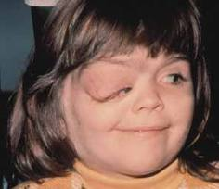
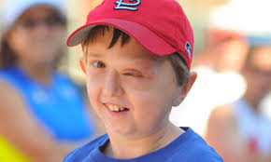
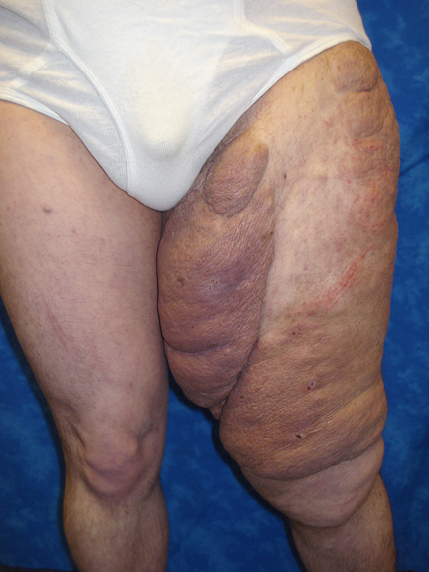
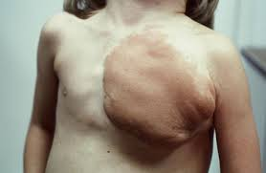

Slide 4
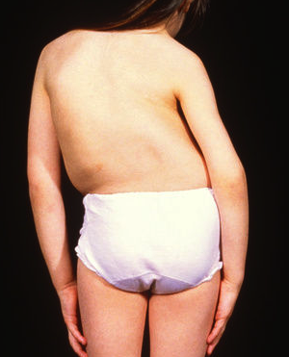
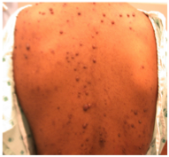
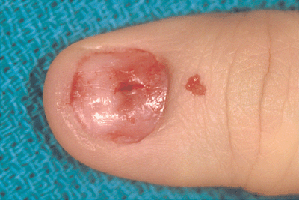
Symptoms highly variable
Plexiform Neurofibromas (PNs)
Dermal tumors
Scoliosis
Glomus tumors
Chronic headaches
Gastrointestinal problems

Slide 5
Neurofibromatosis Type 1
Cognitive impairments
Learning disabilities, ADHD common
Social-emotional problems

Slide 6
Pain in NF1
NIH Pediatric NF1 Research Program
Pain has been reported in 53% of youth with NF1 and PNs (Kim et al., 2009)
33% of children taking pain medication
93% of adolescents taking pain medication continue to report pain that interferes with daily functioning

Slide 7
Pain in NF1
Primary treatment: surgery
Difficult due to location (along nerve tissue)
Regrowth is common
Experimental drugs to reduce tumors
Most have unpleasant side effects
Only one is showing promise in early testing

Slide 8
ACT for Chronic Pain
In 2011, APA Division 12 determined that ACT has “strong research support” for targeting chronic pain in general
Significantly improves pain interference, pain intensity, pain-related disability, depression, anxiety, and quality of life (Veehof et al., 2011)
Effective with various types of chronic pain – osteoarthritis, neuropathic pain, lower back pain, fibromyalgia, sickle cell anemia, etc…
No published studies with NF1

Slide 9
ACT for Pain in Youth
RCT with children and adolescents with long-term idiopathic pain
Ten weekly 1-hour sessions
Parents: 1-2 90-minute session(s)
ACT group improved at 6 months in pain-related functioning, pain interference, and health-related QOL
Wicksell, Melin, Lekander & Olsson (2009)

Slide 10
Pilot Protocol
2-day small-group workshop
Eligibility Criteria
Adolescents/young adults (AYA) between 12-21 years
Confirmed NF1 diagnosis
Response of 3 or higher on pain interference item (1 – 5 scale) from self-report or parent-report QOL measure
“I have pain that keeps me from doing what I want.”
One parent willing to participate

Slide 11
ACT Pilot Protocol
Study Objective: Determine the feasibility and efficacy of an ACT intervention on pain outcomes
Primary Outcome Measure
Modified Brief Pain Inventory (MBPI)
12-item self-report measure
0 = does not interfere, 10 = completely interferes
“How much did pain interfere with your ___ in the past week?”

Slide 12
Measures
Domain | Measure
Pain Interference | Modified Brief Pain Inventory (MBPI)* Pain Interference Index (PII-SR, PII-P)
Pain Intensity | McGill Visual Analogue Scale (VAS)
Functional Disability | Functional Disability Inventory (FDI adol., parent)
Pain Acceptance | Chronic Pain Acceptance Questionnaire Parent Acceptance of Pediatric Illness Questionnaire
Pain-related Anxiety | Pain Anxiety Symptoms Scale (PASS-20)
Depression | Center for Epidemiological Studies (CES-D)
Quality of Life | Impact of Pediatric Illness Scale (IPI adol., parent)
Parent Mood | Brief Symptom Inventory (BSI-18)

Slide 13
Acceptance
CPAQ (McCracken, Gauntlett-Gilbert, & Eccleston, 2010)
Keeping my pain under control is the most important thing whenever I am doing something.
When my pain increases, I can still do things I have to do.
PAPIQ (Masuda et al., 2010)
Symptom control must come first whenever my child does anything.
I cannot bear to see my child struggling.
It is possible for my child to live a normal life even though they have this chronic illness.
Notes:
Acceptance of chronic pain related to lower pain-related impairment and pain anxiety (REFS – Huggins HIV; )

Slide 14
Measures
Domain | Measure
Pain Interference | Modified Brief Pain Inventory (MBPI)* Pain Interference Index (PII-SR, PII-P)
Pain Intensity | McGill Visual Analogue Scale (VAS)
Functional Disability | Functional Disability Inventory (FDI adol., parent)
Pain Acceptance | Chronic Pain Acceptance Questionnaire Parent Acceptance of Pediatric Illness Questionnaire
Pain-related Anxiety | Pain Anxiety Symptoms Scale (PASS-20)
Depression | Center for Epidemiological Studies (CES-D)
Quality of Life | Impact of Pediatric Illness Scale (IPI adol., parent)
Parent Mood | Brief Symptom Inventory (BSI-18)

Slide 15
Methods
22 potentially eligible patients identified
6 declined to participate
2 no longer eligible
14 adolescent-parent pairs enrolled
2 adolescents did not complete workshop
2 adolescents and 5 parents did not return 3-month questionnaires
10 adolescents and 7 parents presented here

Slide 16
Day 1
Consent
Baseline Questionnaires
ACT Session 1
Day 2
ACT Session 2
ACT Session 3
Workbooks
1 month
Telephone “booster session”
3 months
Follow-up questionnaires

Slide 17
Intervention
Mindfulness
Mindful breathing
Noticing
Body scans
Pain
Behavior A
Go to bed

Slide 18
Intervention
Mindfulness
Mindful breathing
Noticing
Body scans
Pain
Go to bed

Slide 19
Intervention
Acceptance
Expansion exercise:
Observe
Breathe
Create space
Allow

Slide 20
Intervention
Defusion
“I used to think that the brain was the most wonderful organ in my body. Then I realized who was telling me this.”
~ Emo Phillips
“I have to go to bed.”
“I notice my mind having the thought that I have to go to bed.”

Slide 21
?
?
Pain
Go to bed
?
?
?
?

Slide 22
Intervention
Values: Who or what is important to you?

Slide 23
Go to yoga class
?
Read a book
?
Pain
Go to bed
?
Body scan
?
Do math homework
Call a friend
?
?

Slide 24
Intervention
Willingness and Commitment
Tug-of-war + Demons on the boat

Slide 25
Intervention
Bringing it all together…
“ACTing Out” exercise

Slide 26
Go to yoga class
Read a book
Pain
Go to bed
Body scan
Do math homework
Call a friend

Slide 27
Go to yoga class
Read a book
Pain
Go to bed
Body scan
Do math homework
Call a friend

Slide 28
Go to yoga class
Read a book
Yoga
class
Read a
book
Call a
friend
Pain
Go to
bed
Call a friend
Pain
Go to bed
Math homework
Body
scan
Do math homework
Body scan

Slide 29
Go to yoga class
Read a book
Call a friend
Pain
Go to bed
Pain
Do math homework
Body scan

Slide 30
Results
Patient Characteristic
Age | M = 17.0 years (range 12 – 20)
 |  | n | %
Gender
Male |  | 4 | 40
Female |  | 6 | 60
Race
White |  | 8 | 80
Hispanic |  | 1 | 10
Biracial |  | 1 | 10
Disease Severity
Mild |  | 3 | 30
Moderate |  | 5 | 50
Severe |  | 2 | 20
PN tumors |  | 10 | 100

Slide 31
Results
Mean PI Rating
* p < .05

Slide 32
Results
Pain Interference: PII
Mean PI Rating
Mean PI Rating
* p < .05

Slide 33
Results
Mean VAS Rating
* p < .01

Slide 34
Results
Mean Score
Mean Score

Slide 35
Results
Variable (Possible Range of Scores) | Means (SD)
 | Baseline | 3-month
Functional Disability – Patient (0-60) | 12.5 (6.9) | 10.4 (6.3)
Functional Disability – Parent (0-60) | 15.3 (9.8) | 18.3 (8.0)
Pain-related Anxiety (0-100) | 19.8 (10.6) | 20.8 (16.1)
Depression (0-60) | 13.3 (7.9) | 12.8 (10.1)
Quality of Life – Self-report (0 – 100) | 68.0 (11.0) | 70.5 (10.7)
Quality of Life – Parent report (0 – 100) | 55.4 (7.1) | 59.4 (6.8)
Parent Mood (T-scores; M=50, SD=10) | 60.6 | 53.7
No significant differences in functional disability, QOL, or patient or parent mood

Slide 36
Results

Slide 37
Conclusions
Feasibility:
Study satisfaction high
Response rates good to fair
Efficacy: Pain outcomes improved
Strengths
Brief intervention
Non-pharmacological option
Limitations
Small sample
Youth with cognitive deficits may have difficulty understanding some concepts

Slide 38
Conclusions
Future Directions
Larger, randomized trials with longer follow-up intervals
Technology: internet-delivered, skype
Adaptations for individuals with younger teens and NF1-related cognitive impairment

Slide 39
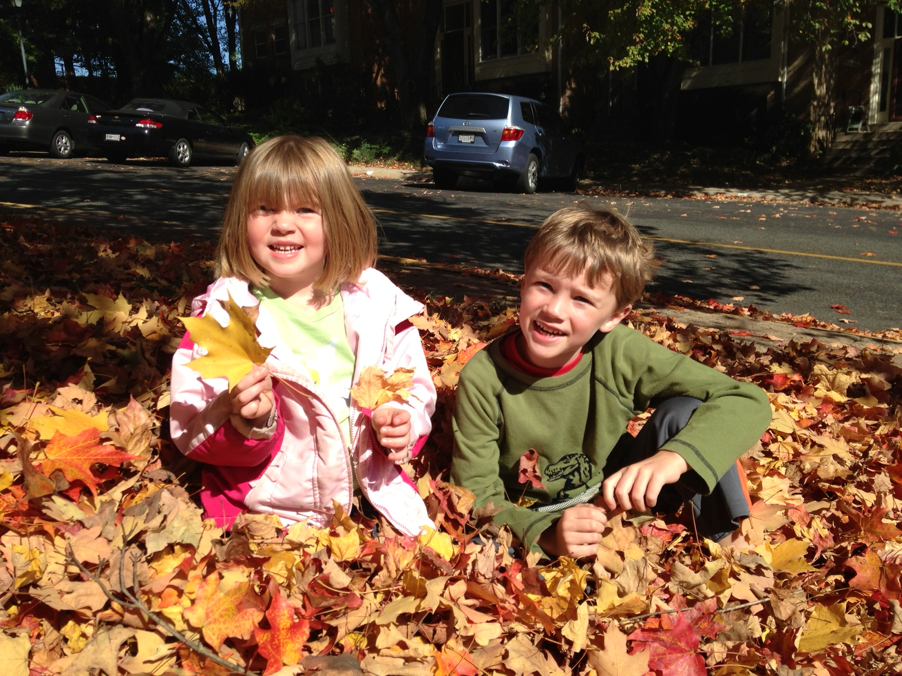
ACT Study: Acknowledgements
Psychology Group
Pam Wolters, PhD
Mary Anne Tamula, MA
Shawn Nelson Schmitt, MA
Katie Burns, MPhil
Ethan Eisen, MPhil
Amy Starosta, MA
NF Medical Team
Andrea Baldwin, CRNP
Andy Gillespie, RN
Brigitte Widemann, MD
Staci Martin Peron, PhD
martins@mail.nih.gov

Slide 40
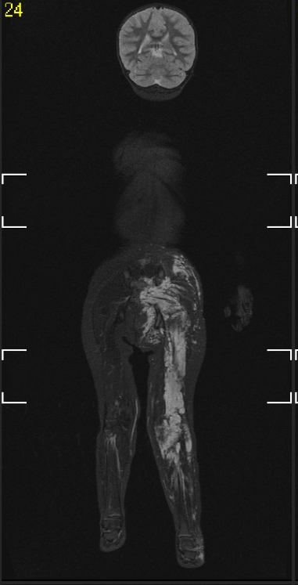
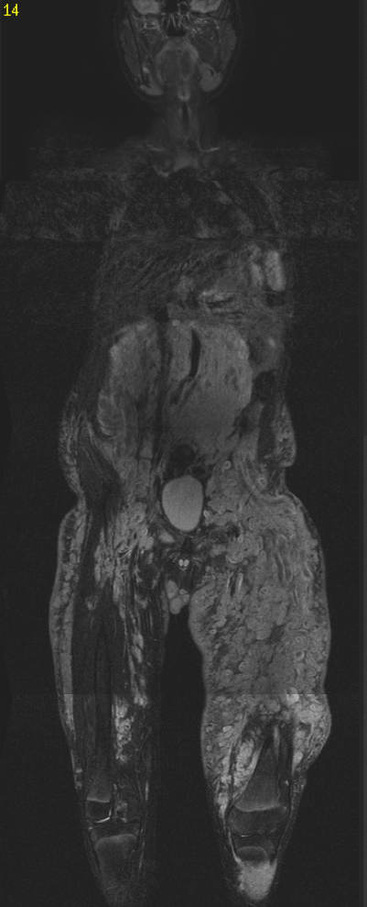

Slide 41
Values
“Maddie”
13 years old
Large plexiform tumor in right arm
Go to school nurse when arm hurt
Skip dance class when in pain
Classroom accommodation: record lectures

Slide 42
Willingness & Commitment
Academic
Record class lectures
Pain
Achievement

